Slide 1
Testbed for Validating Second-Generation TDI and Clock Noise Correction for LISA
Karin Kruuse
Notes:
Hi! I’m Karin Kruuse. I’m a first year PhD student at the albert Einstein Institute in Hannover and I’ll be talking about the LISA testbed we are building there.

Slide 2
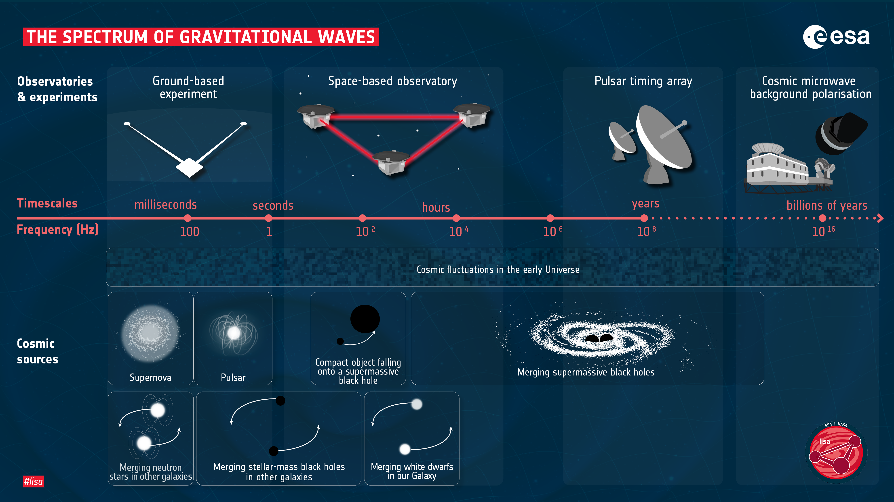
Notes:
So to those who need a reminder, LISA is an ESA led mission to put a gravitational wave detector in space to detect mHz GWs without the Newtonian noise we have here on Earth.

Slide 3
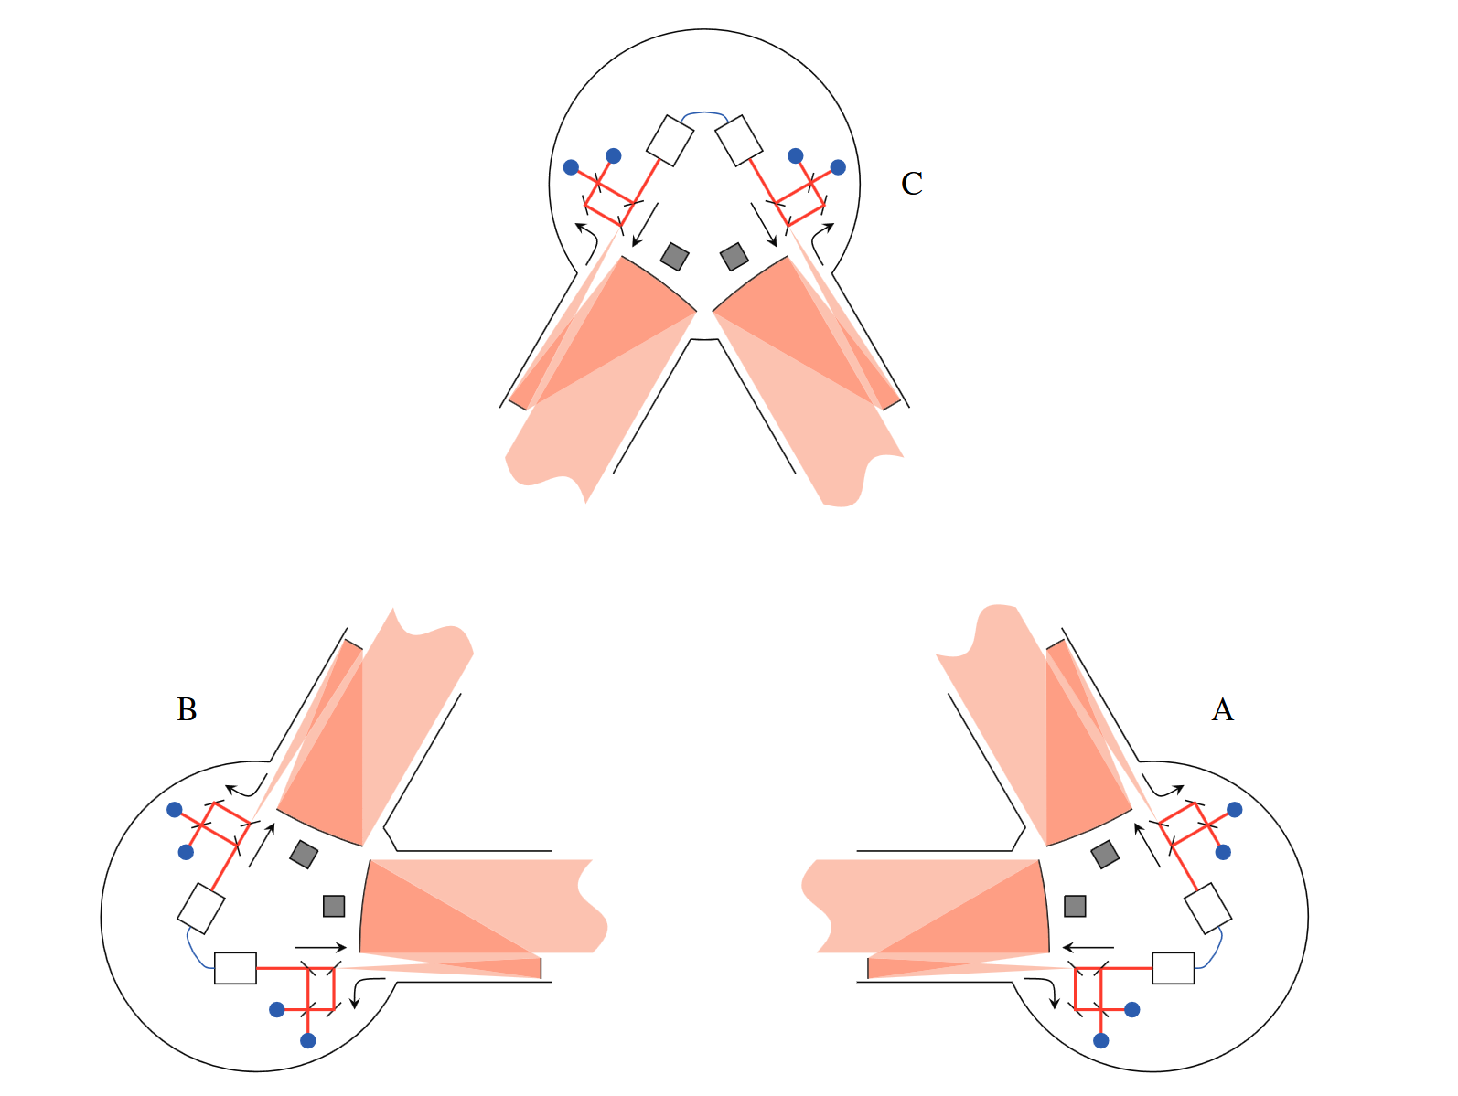
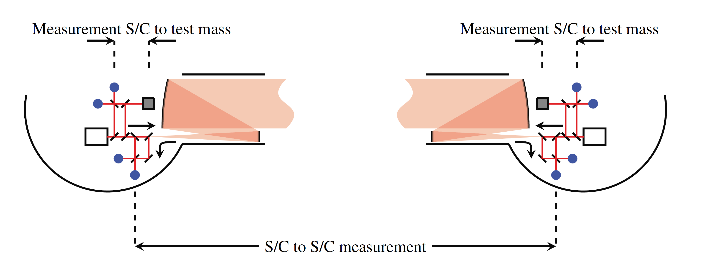
The LISA Satellites
Unequal arm lengths
Split interferometry
Heterodyne interferometry
Jennrich, 2010
Notes:
For this ambitious goal, the iconic triangular constellation will train Earth on a heliocentric orbit. Due to not perfect orbits, the arm lengths are unequal which leads to the biggest noise contribution for LISA signals which is the laser noise. The arm lengths are also time varying which results in Doppler shifts on the inter-satellite laser fields. For LISA heterodyne interferometry is used – meaning the interfering light fields have slightly – MHz – different carrier/central frequencies and the resulting reading from the photodetector will oscillate at the frequency of said difference. This is what we call the beatnote.
From the intersatellite measurement we derive the distance between the spacecraft.
Now, in addition to the intersatellite light fields, the LISA satellites include interferometric measurements between two sources on the same satellite to measure the distances from the spacecraft to each of the test masses. This is often referred to as split interferometry for LISA.

Slide 4
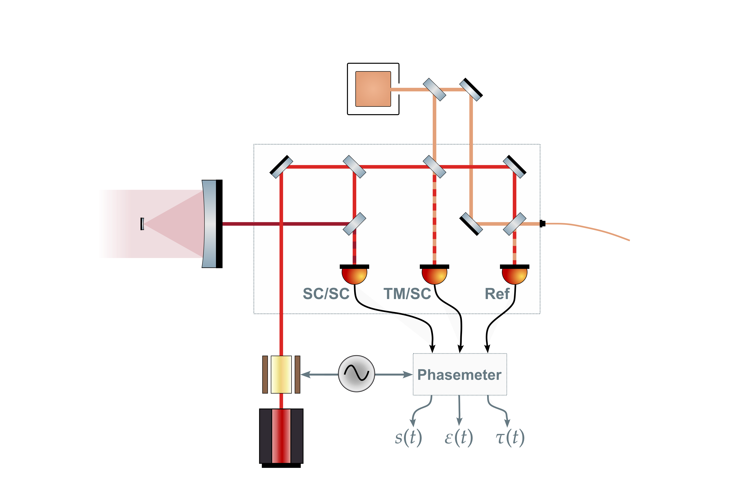
LISA Interferometric Metrology System
Test mass
USO – Ultra Stable Oscillator
– science beat note
– test mass beat note
– reference beat note
Optical bench
Far spacecraft
Adjacent laser
USO
Local laser

Slide 5
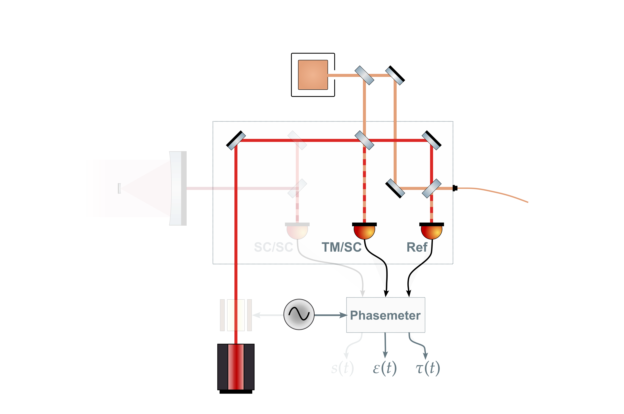
LISA Interferometric Metrology System
Test mass
USO – Ultra Stable Oscillator
– science beat note
– test mass beat note
– reference beat note
Optical bench
Far spacecraft
Adjacent laser
USO
Local laser

Slide 6
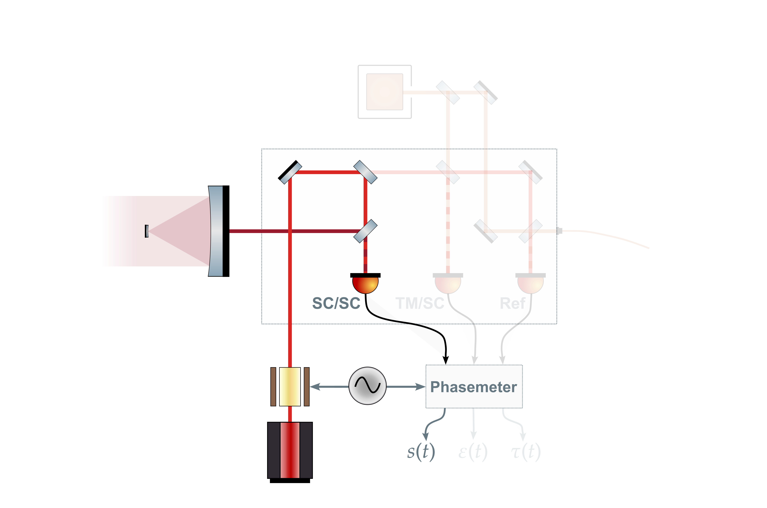
LISA Interferometric Metrology System
Test mass
USO – Ultra Stable Oscillator
– science beat note
– test mass beat note
– reference beat note
Optical bench
Far spacecraft
Adjacent laser
USO
Local laser

Slide 7
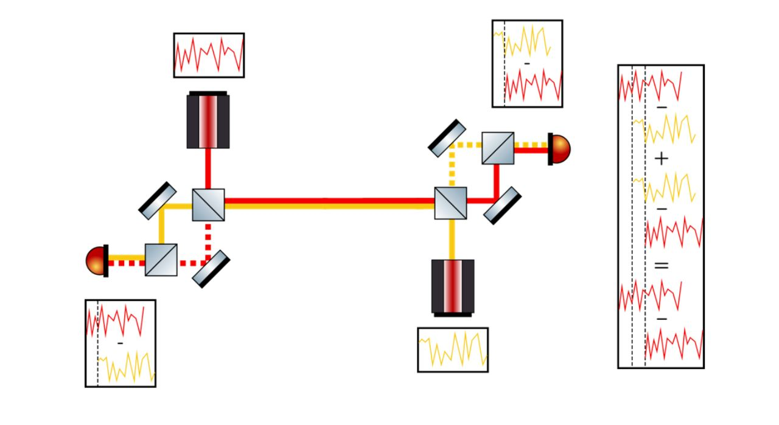
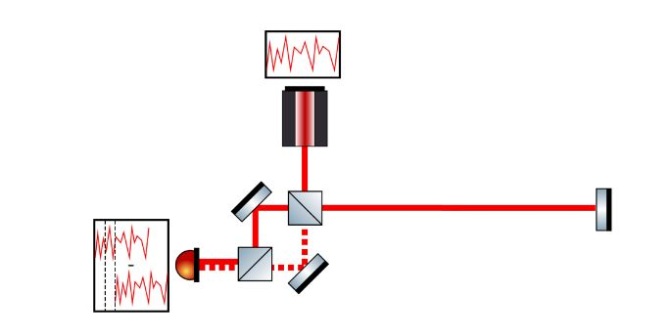
Laser Noise Reduction via TDI
Time Delay Interferometry (TDI) is a cluster of methods to construct virtual equal arms in post-processing.
Transponder signal
Synthesized transponder signal
Hartwig, 2021
Notes:
More text. Maybe add the algebra
This is kind of a start for the problem statement

Slide 8
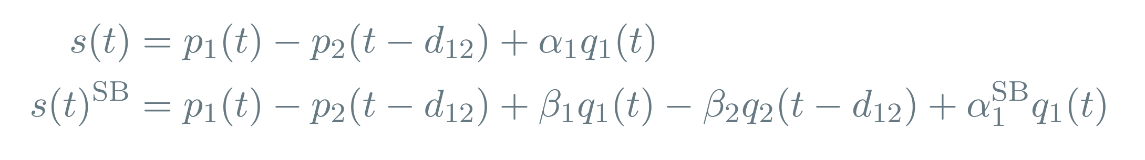
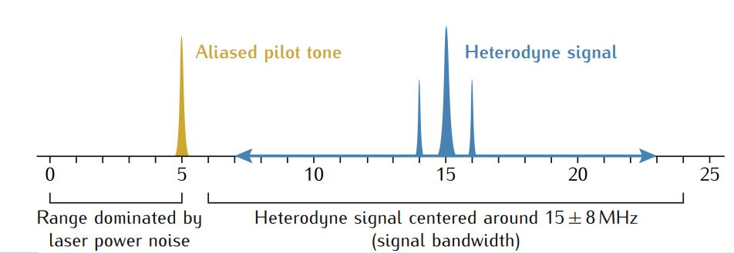
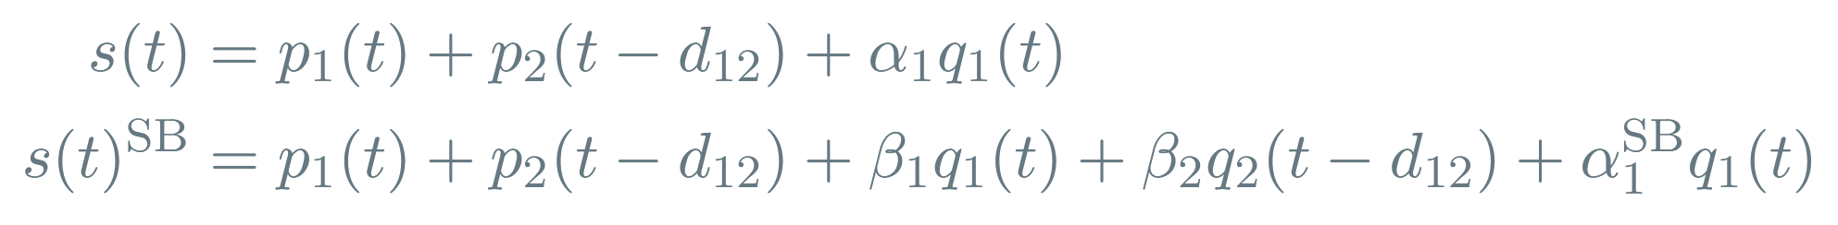
Clock Noise Reduction
After demodulation, considering laser noise and clock jitter:
Lisa metrology system-final report, 2014

Slide 9
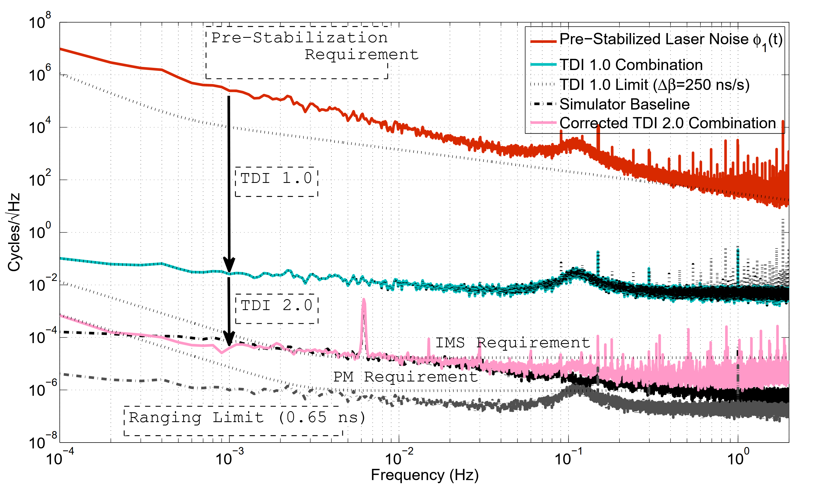
Previous Experiment
TDI 1.0
Strain amplitude 4.35×10⁻²⁰ m/m
TDI 2.0
Mitryk, 2012: Laser Noise Mitigation through Time Delay Interferometry for Space-based Gravitational Wave Interferometers Using the UF Laser Interferometer
Notes:
Decades ago a testbed was build in University of Florida. Our design, which i will soon enough get to, was very similar to ours – so it is the predecessor to our testbed. The experiments performed were able to show that with TDI it is infact possible to cancel the laser noise orders of magnitude while preserving the gravitational wave signal. The strain used here is about two orders of magnitude higher that what was expected for LISA though. Overall the testbed was largely limited by the technology of the time – the baseline noise was high and the possibilities with adding GWs were limited. The testbed also didnt include the laserfield modulation for clock noise removal.

Slide 10
miniLISA
miniLISA is a hardware testbed that aims to simulate LISA’s signal chain and test whether we can recover a gravitational wave signal from a realistic, noisy system.
To start with, we want to test the combination of second generation TDI and the clock noise removal post-processing methods on experimental data.
miniLISA could also offer a substitute to modelled noise sources included in current data analysis.

Slide 11
Current Status
A fully electronic implementation of the interferometry system together with a delay and gravitational wave injection has already been developed and is being tested.
Time varying delays
Doppler shifts for both the carrier and sidebands
Gravitational wave injection
Notes:
DIAGRAM!

Slide 12
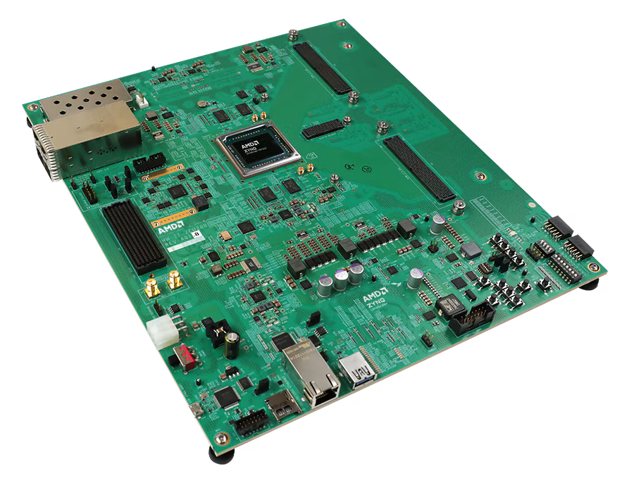
The Delay Line
The center of the experiment is the delay line.
The added varying delays, gravitational wave signals and Doppler shifts are controllable via a Python-based interface.
Signal Processing on the Delay Line
AMD Zynq™ UltraScale+™ RFSoC ZCU208 Evaluation Kit

Slide 13
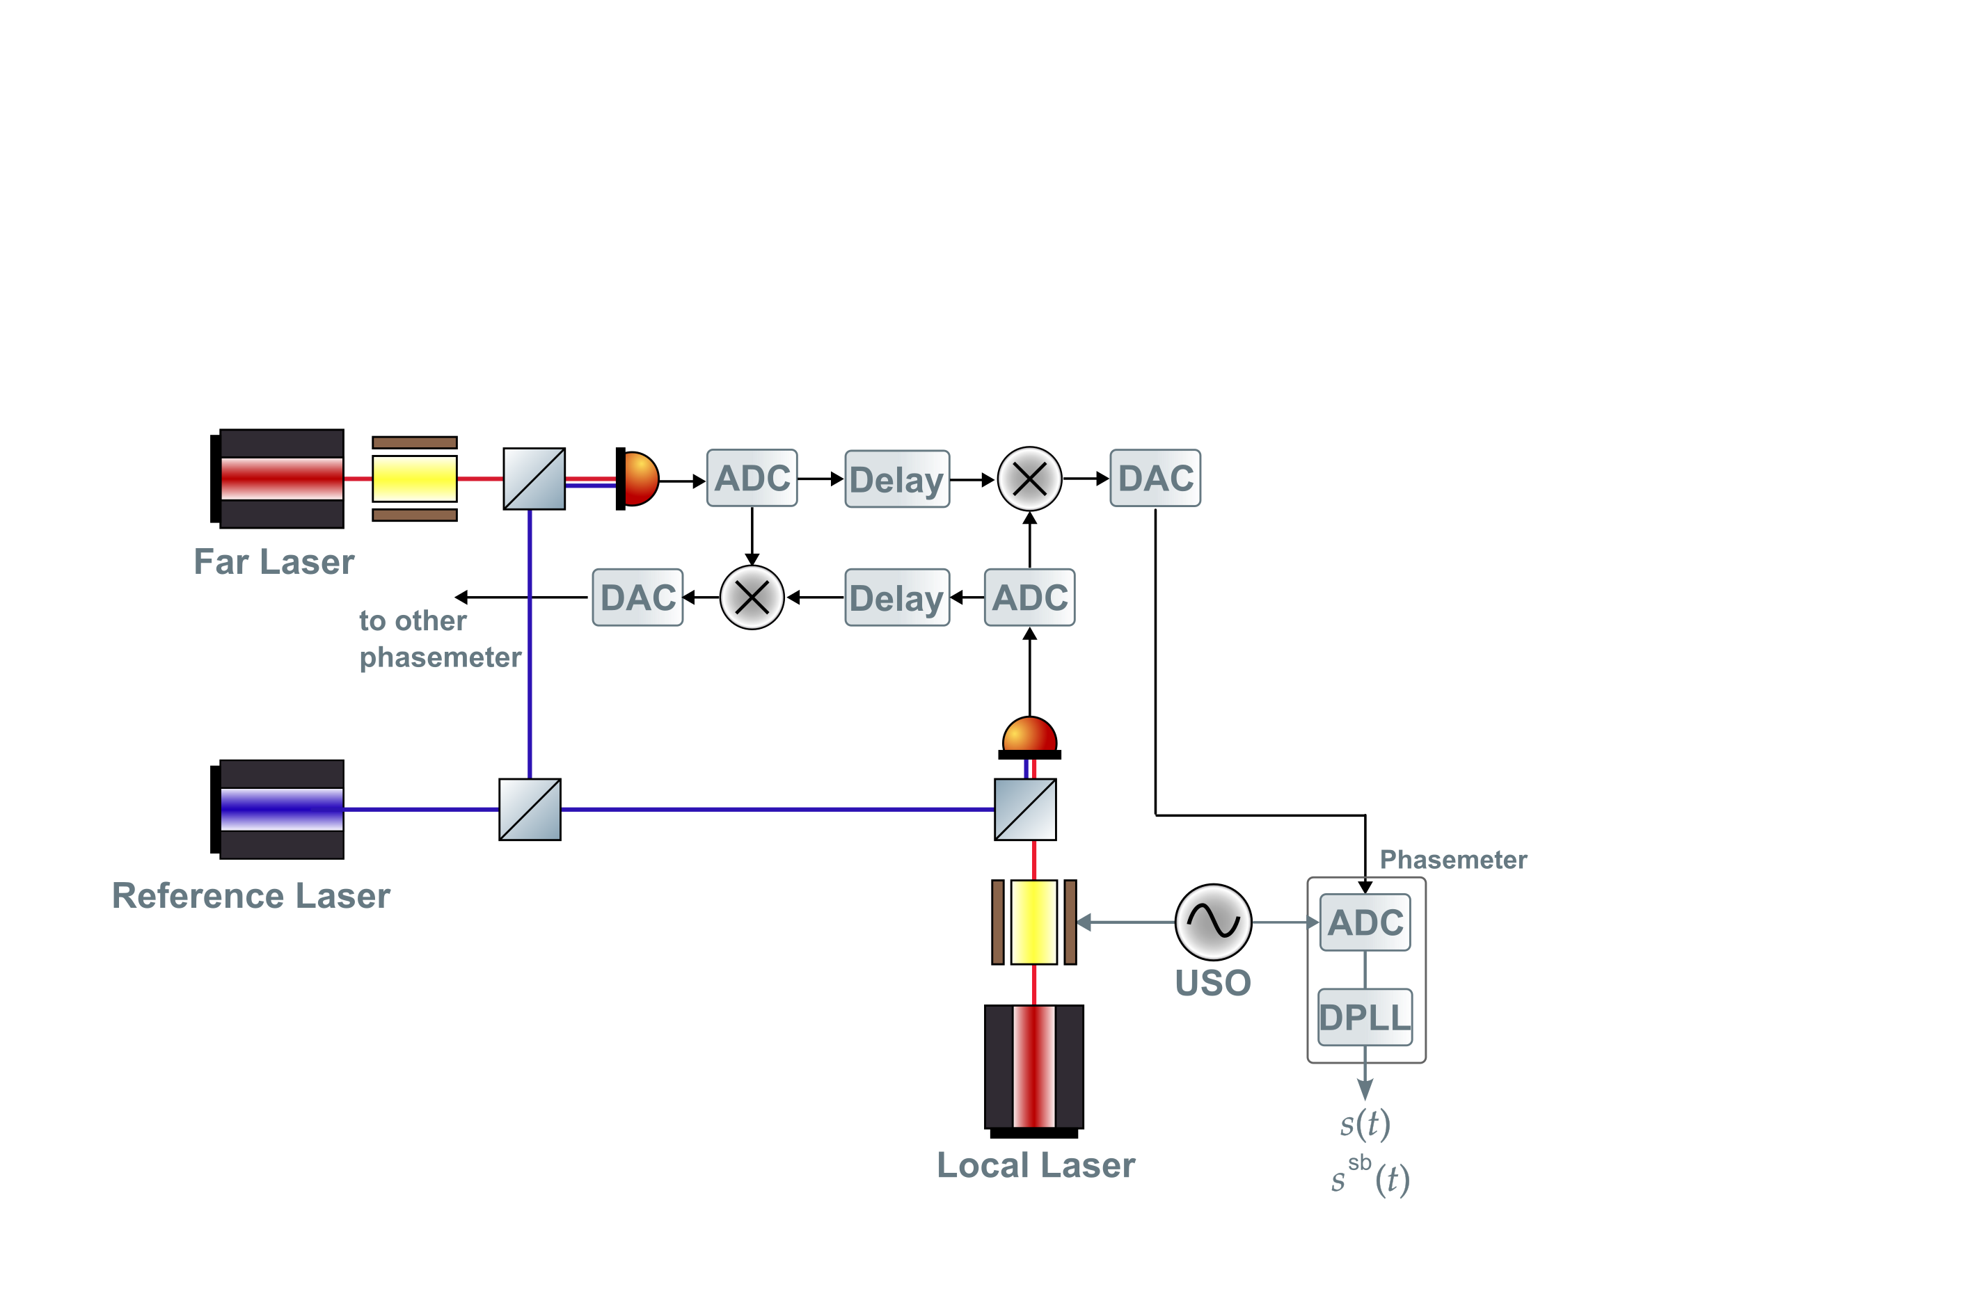
One-arm Phase Measurement
Set up for generating one LISA-like arm link.
Sci IF
~15 MHz
~60 MHz
~10 MHz
Notes:
typo

Slide 14
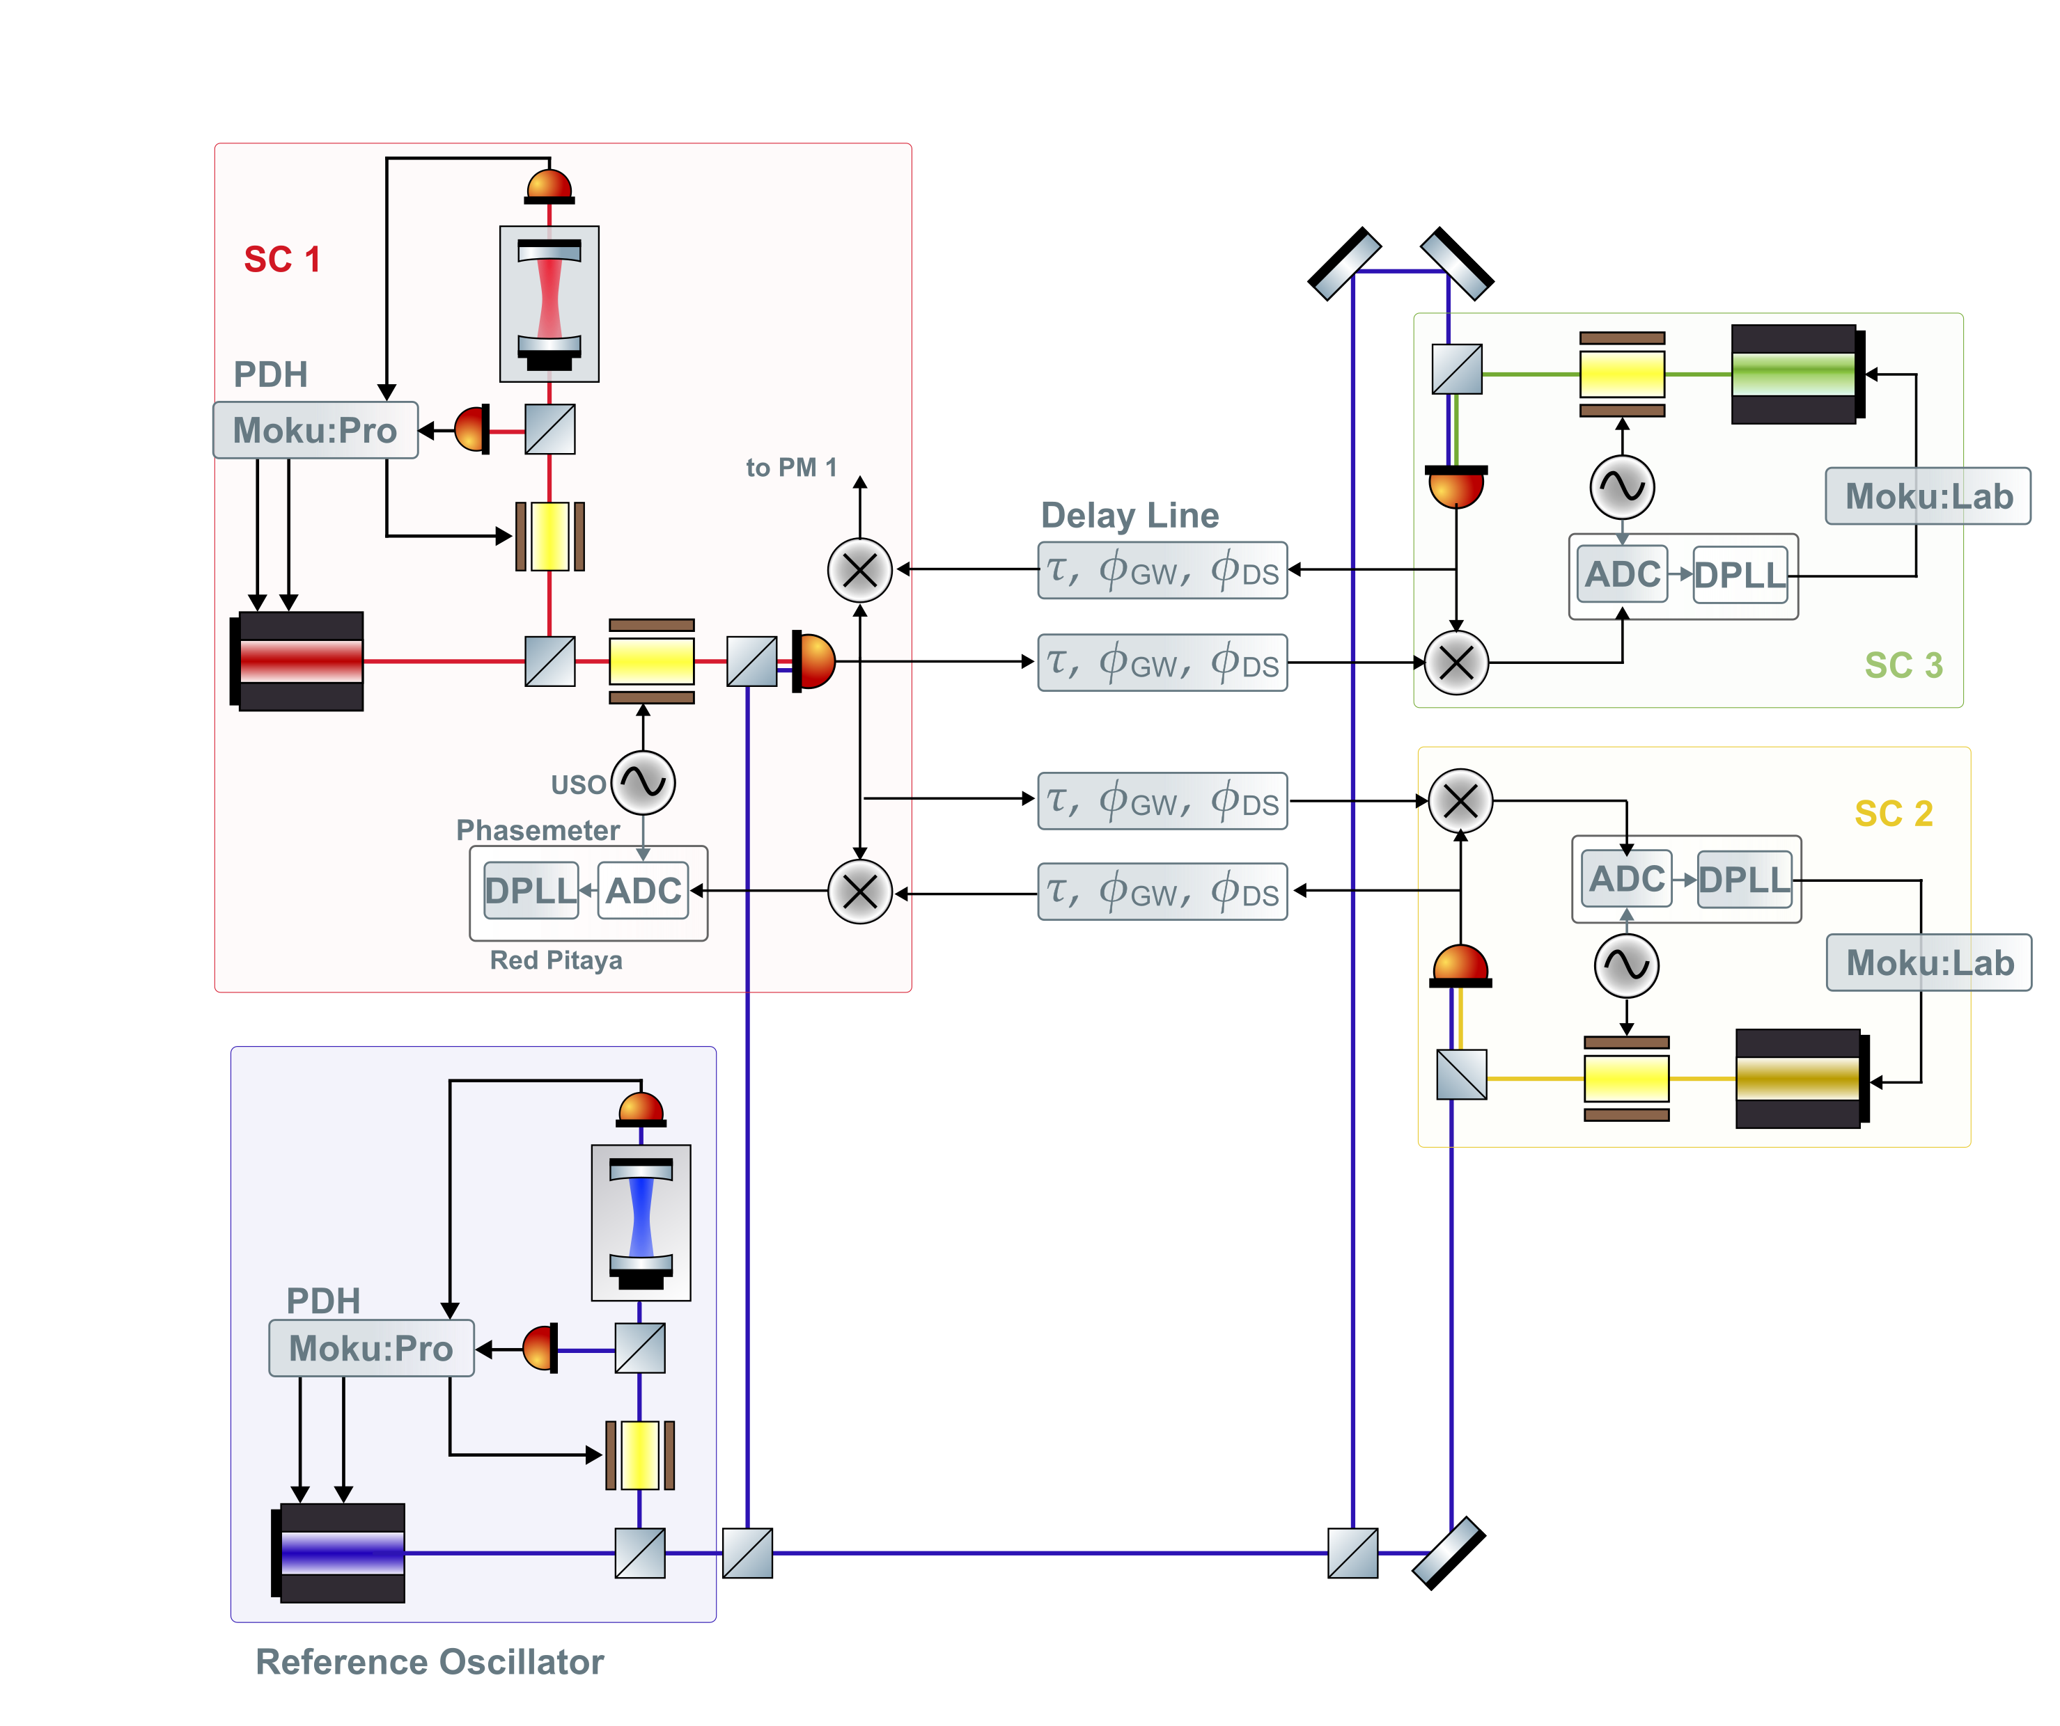
Two-arm Testbed
Notes:
I have to remake this shit

Slide 15
Possible Additions
Third Arm
Necessary for better peremeter estimation
More elaborate clocking system
To better replicate the clock noise removal in LISA
Phase shifter to emulate the Test mass motion

Slide 16
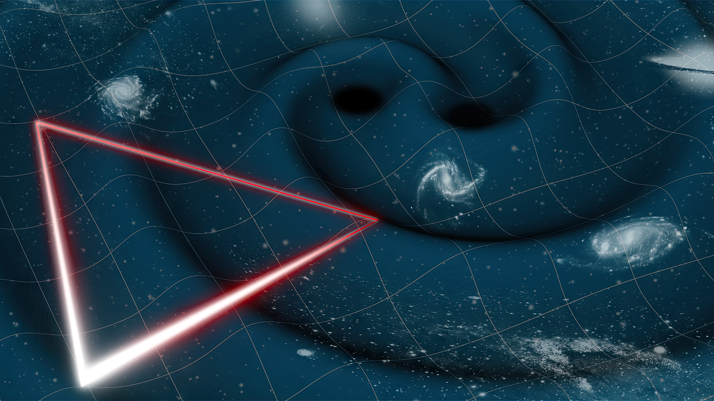
Thank you for listening!

